Slide 1
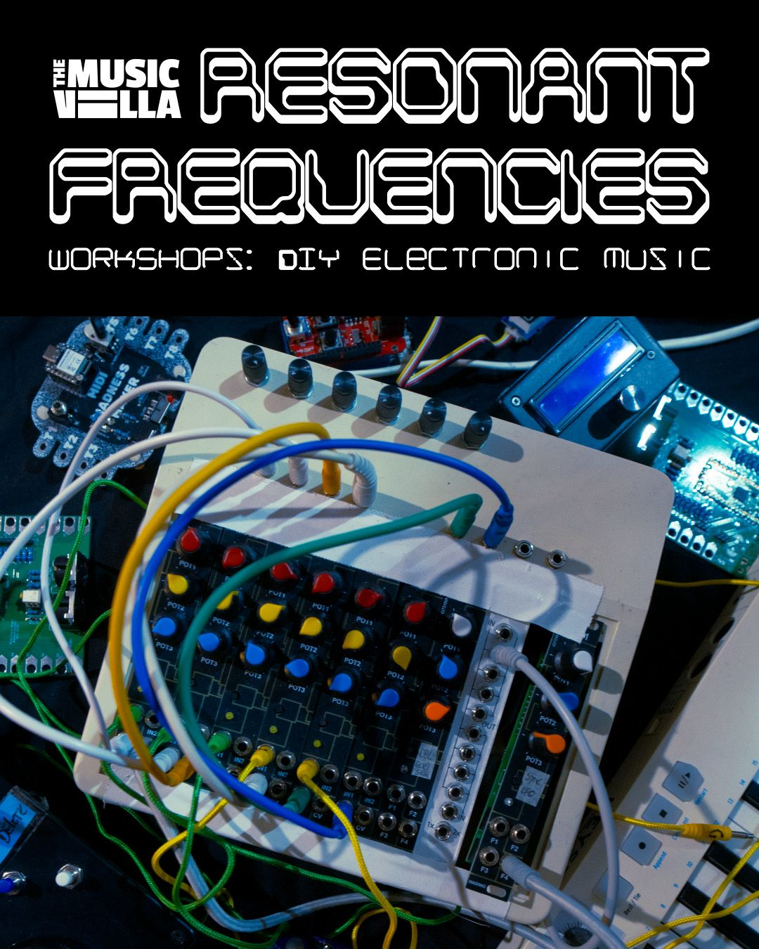
Arduino &
Mozzi
DIY Synthesizer

Slide 2
Arduino &
Mozzi
Step 1: Download the Arduino software and install it
https://www.arduino.cc/en/software/
Step 2: Connect the Arduino board to a USB port
Use a dongle or USB hub if needed
Step 3: Start the Arduino software and choose the right board
We use a Arduino Leonardo
Step 4: Select the right serial port
On Windows look for COM , on Mac look for /dev/cu...
DIY Synthesizers with Arduino
Step 5: Download the examples and open ‘1-Basic_Blink.ino’
https://github.com/ichingxs4all/Midi-MusicVilla/releases/download/Resonant_Frequencies_WS2/Mozzi-MusicVilla.zip
Step 6: Try to Upload the Sketch by pressing the ‘Arrow Right’ button

Slide 3
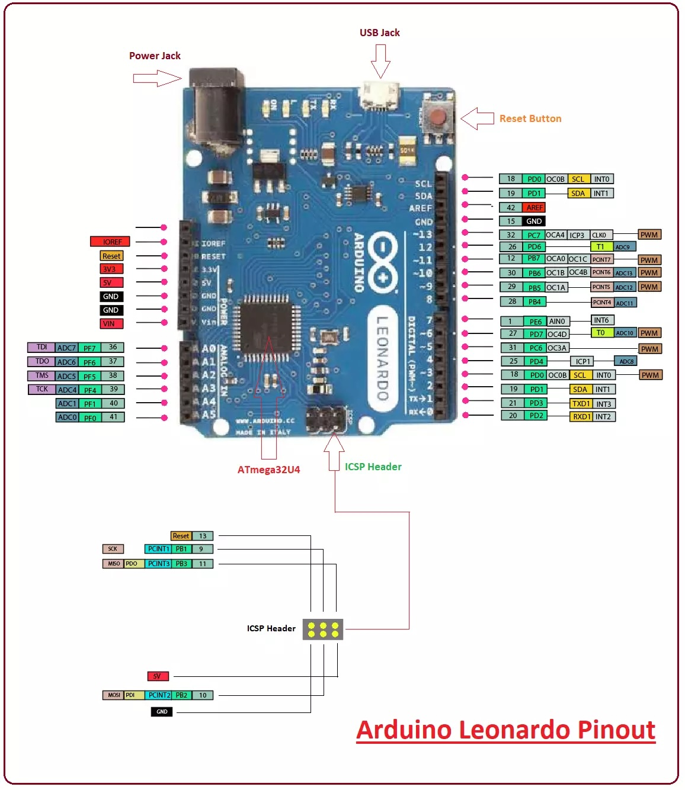
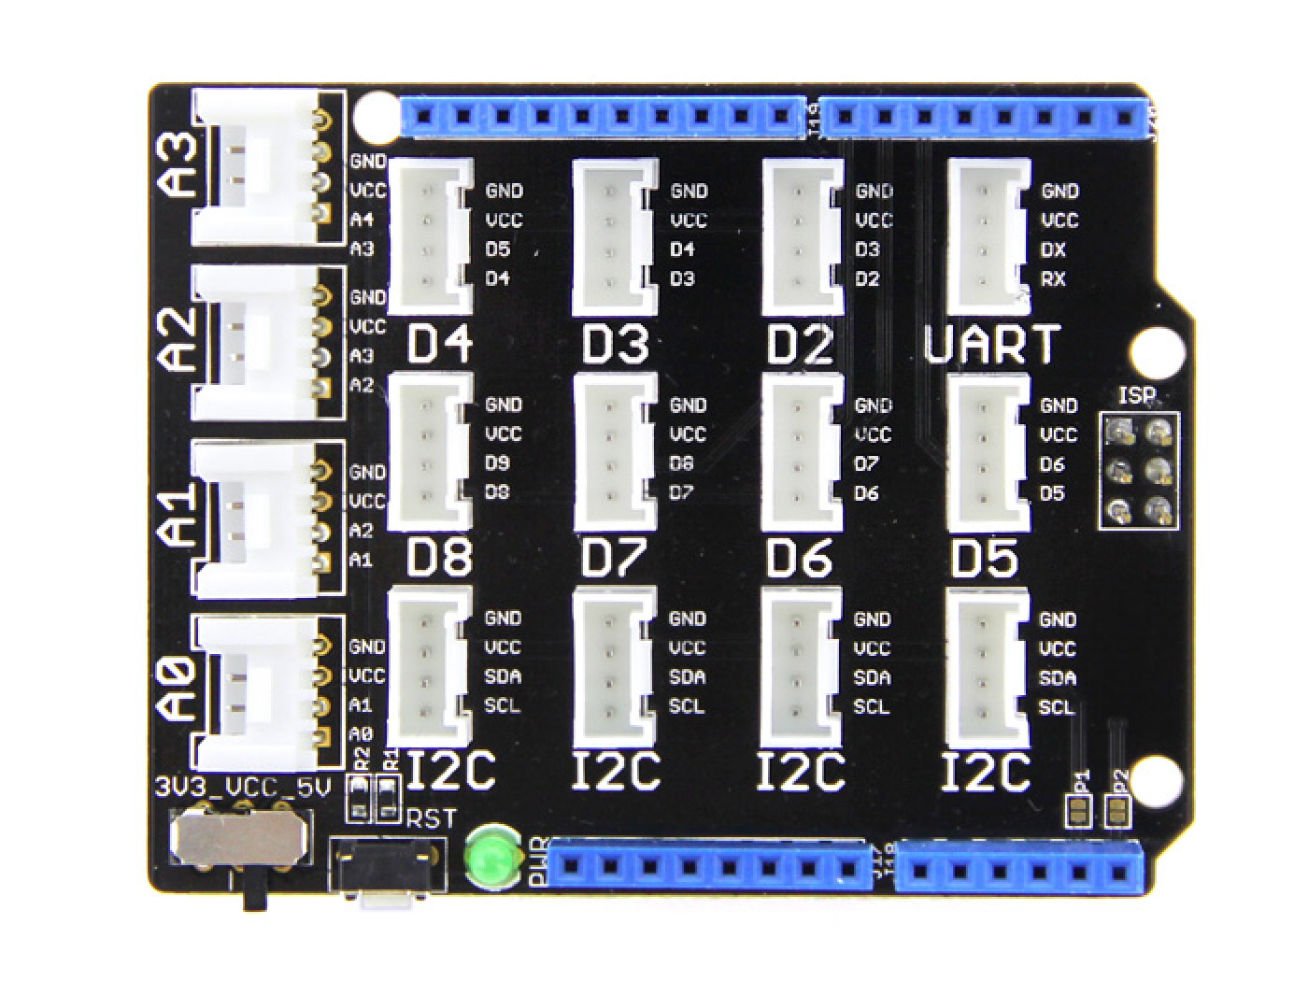





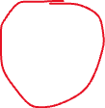
Arduino Leonardo + Grove shield
LED
MIDI INTERFACE
Touch button
LDR
DISTANCE SENSOR
Potmeter

Slide 4
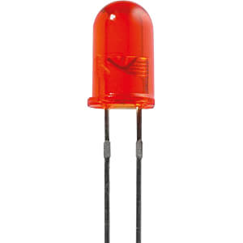
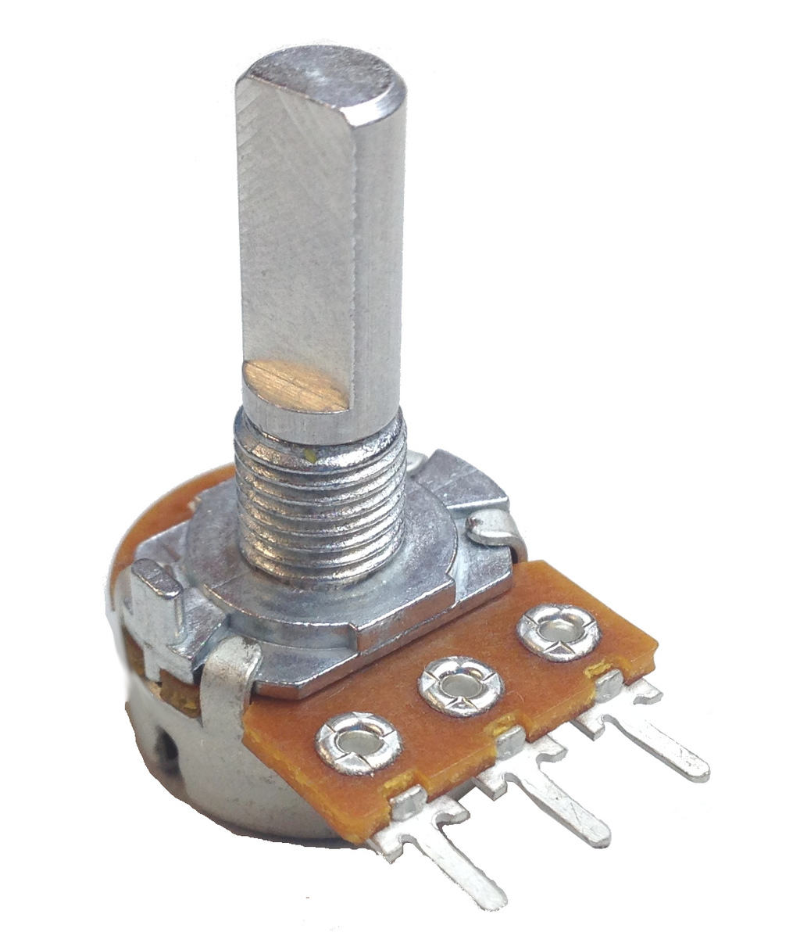
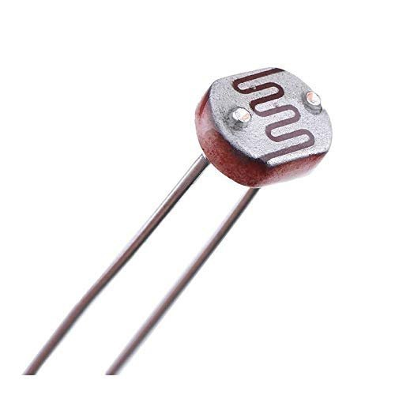
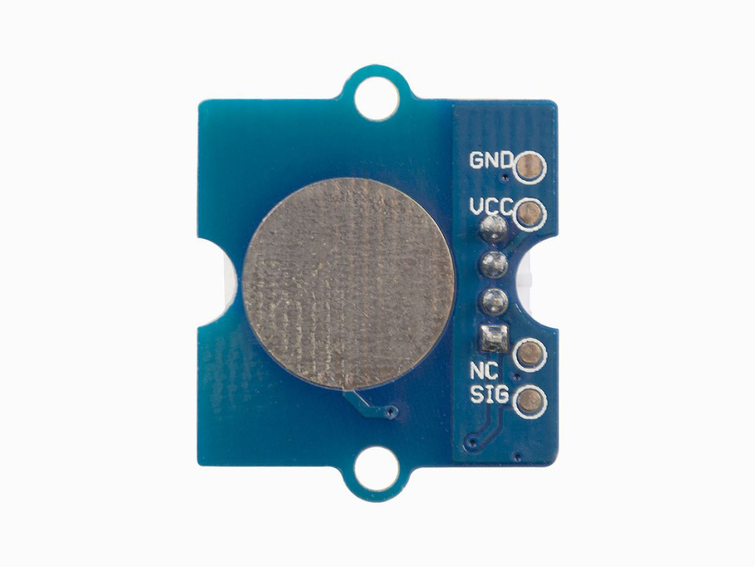
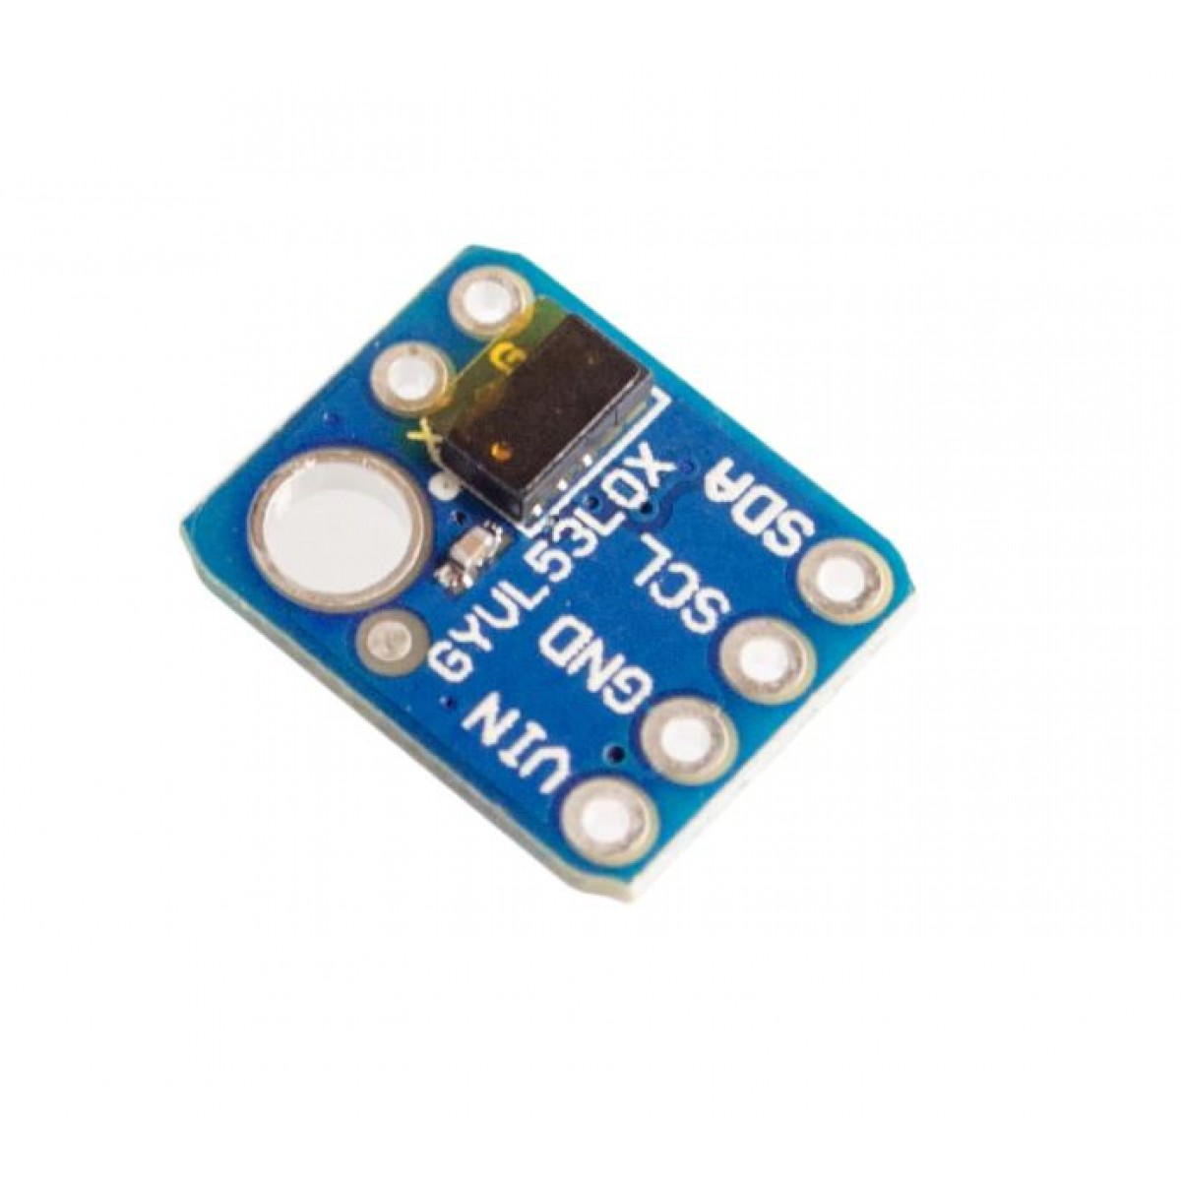
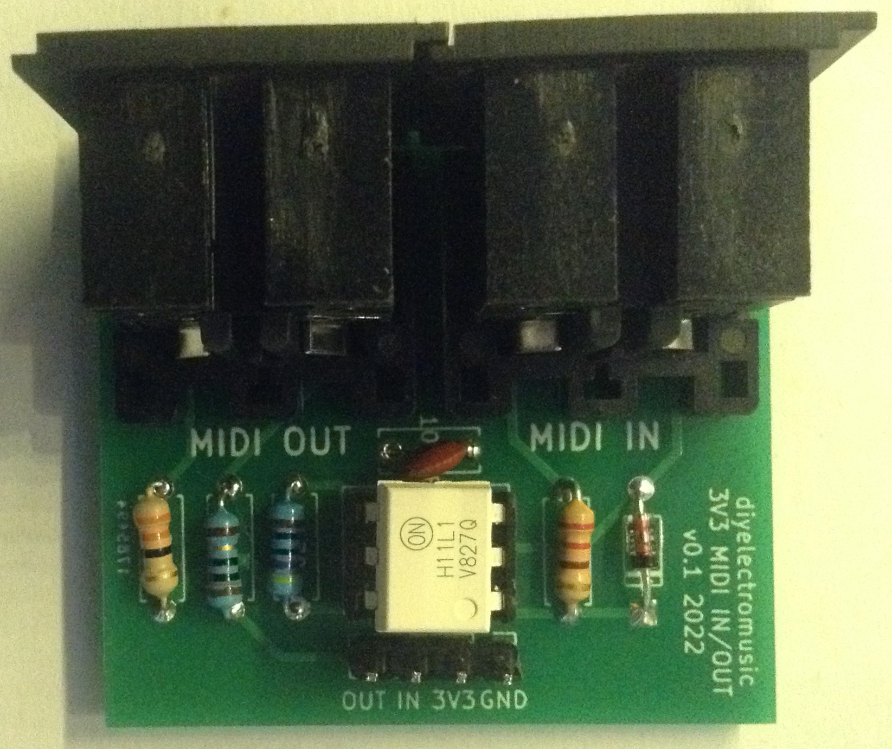
Sensors & MIDI interface used
LED
POTMETER
LDR
TOUCH BUTTON
AFSTAND SENSOR
MIDI INTERFACE

Slide 5
To be sure !
Don’t connect anything while powered through USB
Don’t set the switch on the shield to 5V..keep it on 3.3V
Make sure the sensors do not touch anything metal
Ask if not sure ;-)

Slide 6
Have Fun and Rock On !

Slide 7
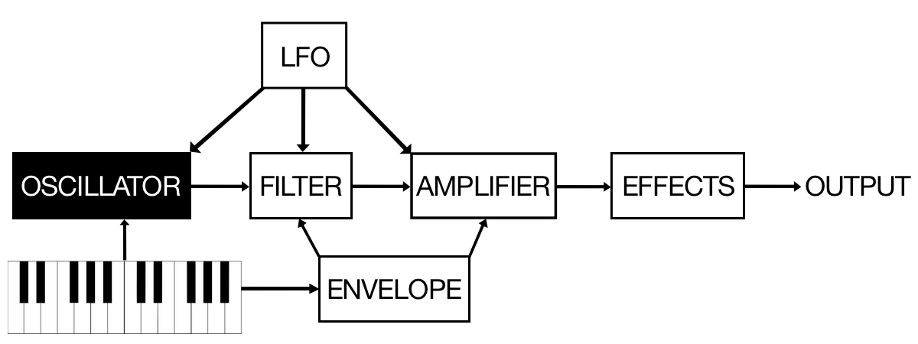
Have Fun and Rock On !

Slide 8
About MoZZi
https://sensorium.github.io/Mozzi/
https://thewessens.net/synthbook/ - constructive-synthesis

